Slide 1
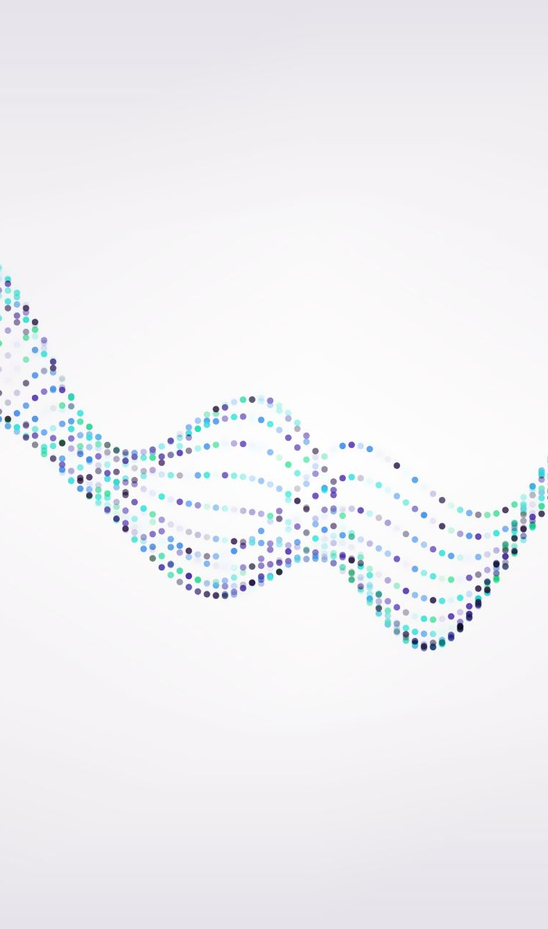
GNN Explainability Methods
Harshit Kumar
Fall Co-op 2023
The Jackson Laboratory

Slide 2
Introduction
Model Explainability Methods
Help you understand and interpret predictions made by machine learning models.
What is our model learning?
Which part of input is most important for our predictions?
Example use case #1: in image classification, it helps determine which section of the image model is looking at while making predictions.
Example use case #2: identifying which genes are relevant for specific biological processes or diseases, thus streamlining lab experiments for novel drug discovery and understanding disease mechanisms.

Slide 3
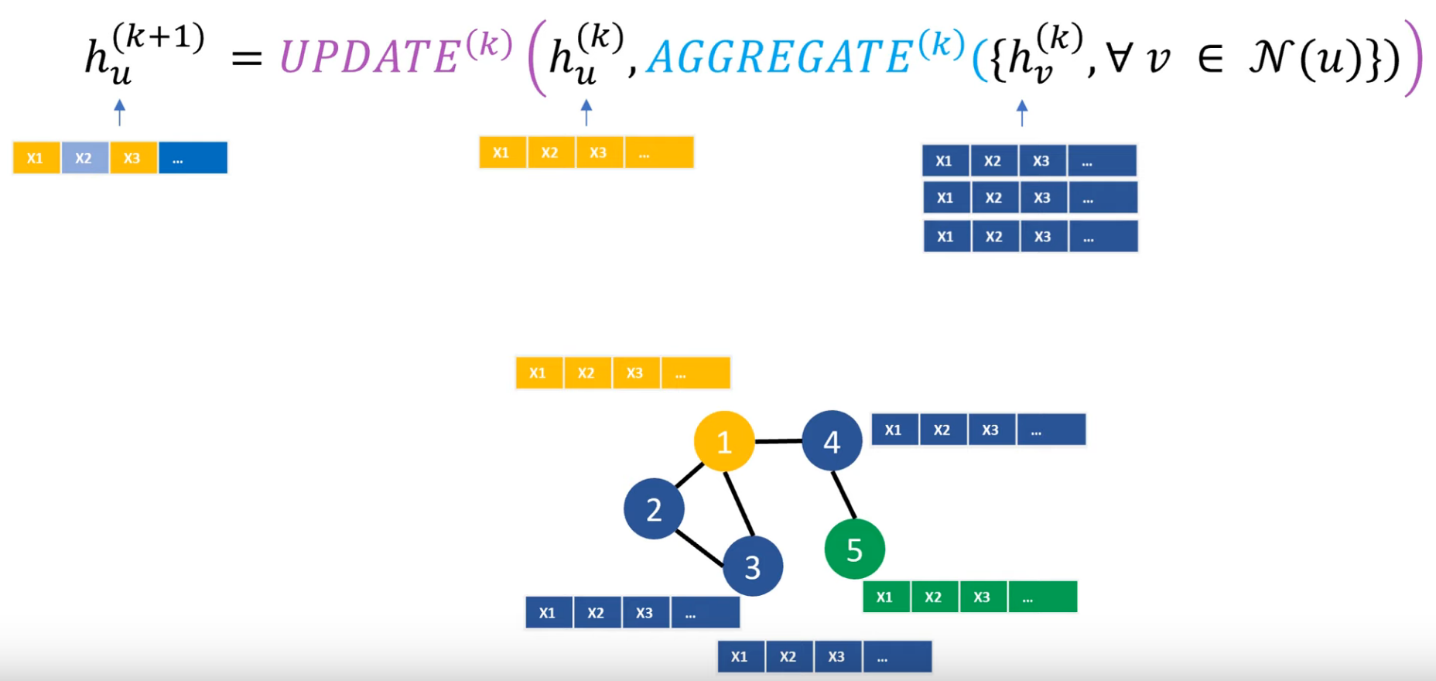
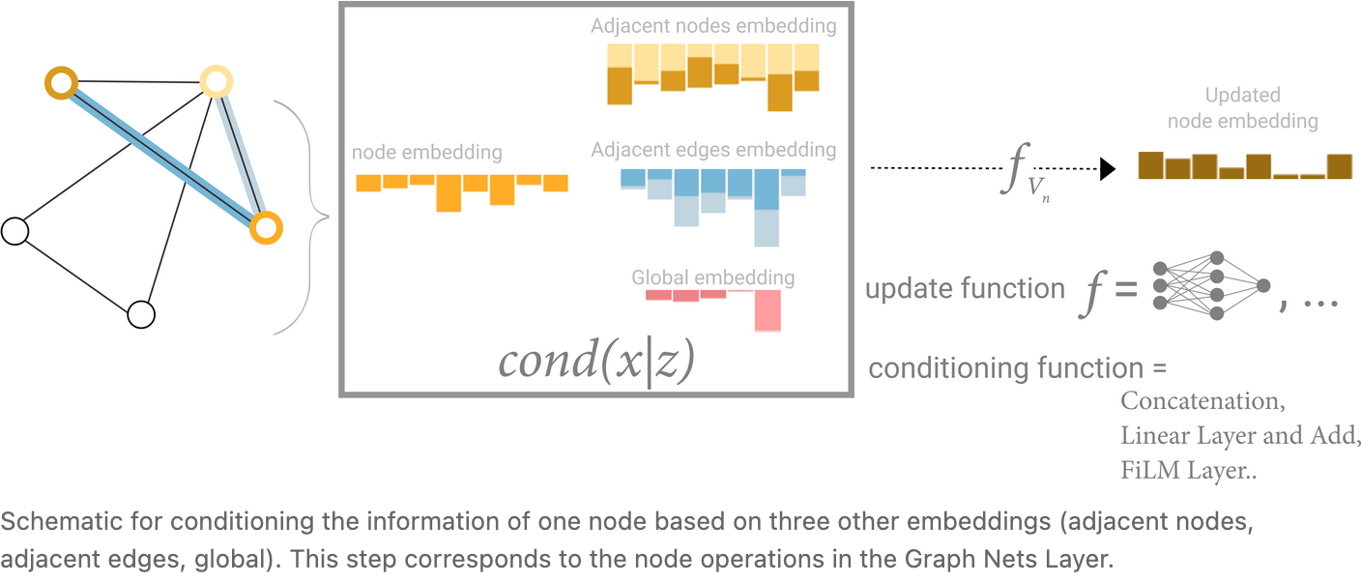
Graph Neural Networks
Message passing
https://youtu.be/ABCGCf8cJOE?si=Di_Iw5pbOZYv8Jeb
https://distill.pub/2021/gnn-intro/

Slide 4
Gradient based methods
Objective: the primary goal of gradient-based methods is to quantify how sensitive the model's prediction is to changes in input features.
How? Compute gradients (derivatives) of the model's prediction with respect to the input features

Slide 5
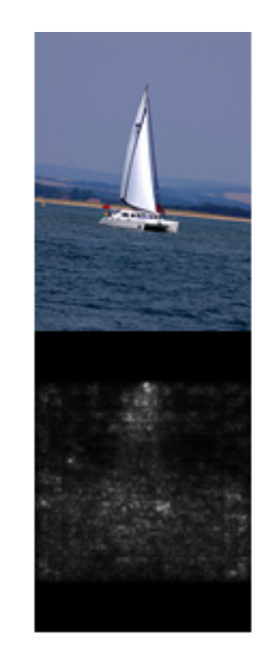
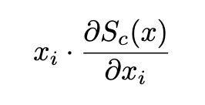
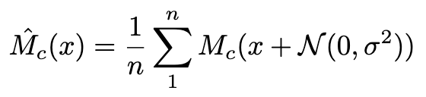
Saliency Maps
Saliency score of feature =
gradient of output wrt input * value(input feature)
where Sc(x) is class score of class c for input x
SmoothGrad: smoothing noisy gradients by taking local gradient average
where Mc(x) is gradient at x
Deep Inside Convolutional Networks: Visualising Image Classification Models and Saliency Maps https://arxiv.org/pdf/1312.6034.pdf

Slide 6
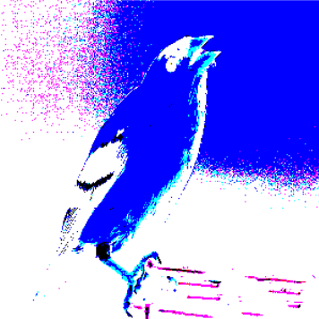
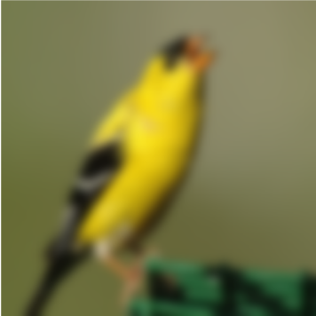
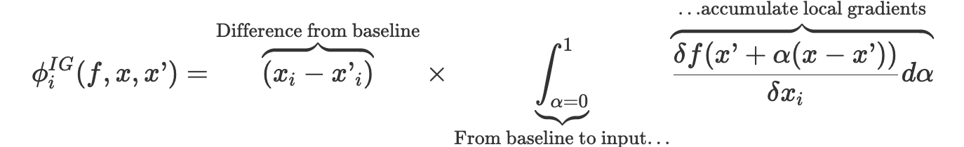
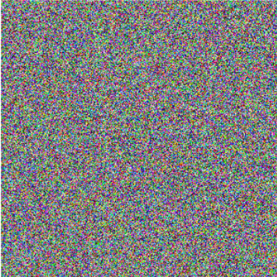
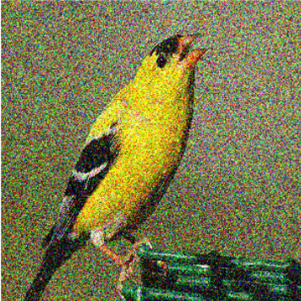
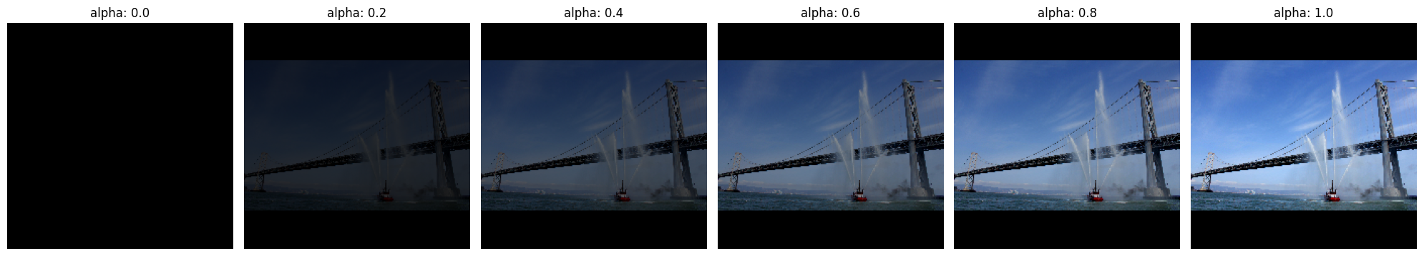
Integrated Gradients
Baselines
max L1 distance
Integrated gradient of i^{th} feature:
blur
uniform
gaussian
Axiomatic Attribution for Deep Networks https://arxiv.org/pdf/1703.01365.pdf

Slide 7
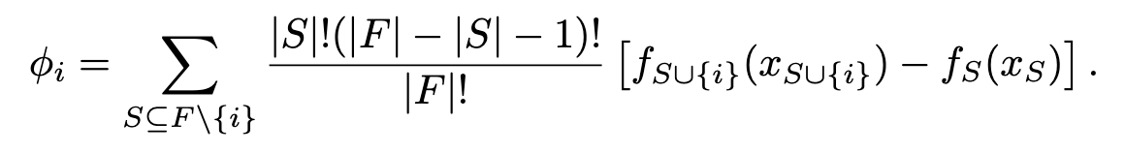
Shapely Additive exPlanations (SHAP)
SHAP assigns each feature an importance value for a particular prediction
A Unified Approach to Interpreting Model Predictions https://proceedings.neurips.cc/paper/2017/file/8a20a8621978632d76c43dfd28b67767-Paper.pdf

Slide 8
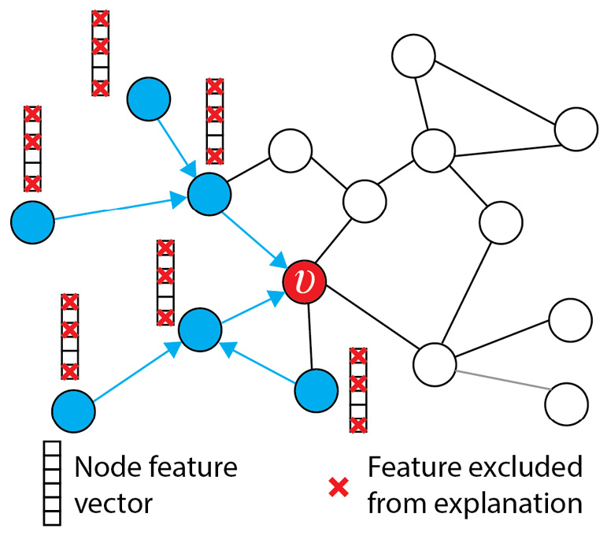
GNNExplainer
GNNExplainer takes a trained GNN and its prediction, and it returns an explanation in the form of a small subgraph Gs of the input graph together with a small subset of node features Xs that are most influential for the prediction.
$$\max{MI \left(Y, \left(Gs, Xs\right)\right)=H\left(Y\right)−H(Y|G=Gs,X=Xs)}$$
Gs
Relaxation: overall optimization problem is reduced to constructing an edge M_{E} and feature M_{F} masks that finds a subgraph that maximizes the mutual information.
A’ = A . sigma(M_{E})
X’ = X . M_{F}
GNNExplainer: Generating Explanations for Graph Neural Networks https://arxiv.org/pdf/1903.03894.pdf
Notes:
The notion of importance is formulated as the optimization of mutual information. The 𝑀𝐼 objective is intractable (exponentially many subgraphs). The authors of GNNExplainer propose a relaxation and change the conditional entropy with a cross entropy. The objective becomes to learn an edge mask 𝑀∈ℝ𝑛×𝑛 and a feature selector 𝐹∈ℝ𝑑, by minimizing the following objective function using gradient descent

Slide 9
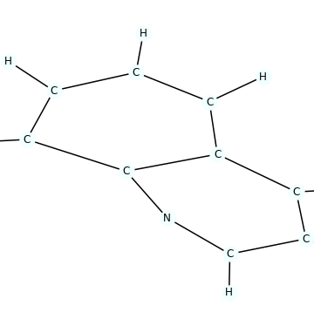
Example: Mutagenicity Dataset
Mutagenicity dataset from TUDatasets.
Used for the task of predicting whether chemical compounds or substances have the potential to cause mutations in DNA.
Data categorized into two classes: mutagen and non-mutagen.
Consists of 4337 molecule graphs where the task is to predict the molecule mutagenicity.

Slide 10
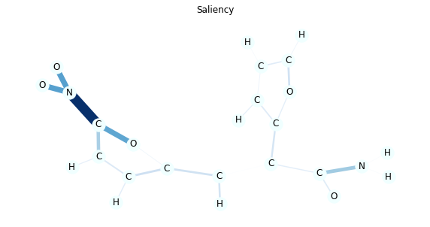
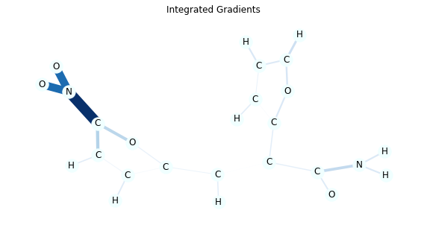
Example: Mutagenicity Dataset Results

Slide 11
Synthetic Graph Dataset Generation
Goal: To generate graph dataset with motifs
Random Graph generation models:
Erdos-Renyi: a graph is constructed by connecting nodes randomly with given probability.
Drawbacks: 1. low clustering coefficient 2. not scale-free network – power law (no formation of hubs)
Watts-Strogatz: solves drawback #1; start with a ring-lattice then randomly pick some links to rewire; produces small-world network; small-world network
Barabasi-Albert: solves drawback #2; start with a small network and add a new node by drawing a fixed given number of links to existing nodes with preferential attachment i.e. the probability of linking to existing node is proportional to that node’s degree.
Notes:
A small-world network is a graph characterized by a high clustering coefficient and low distances

Slide 12
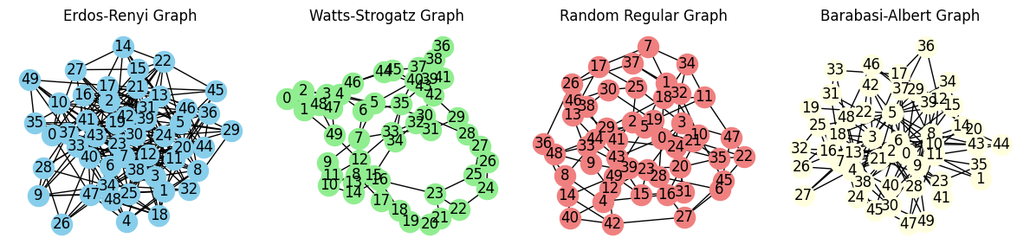
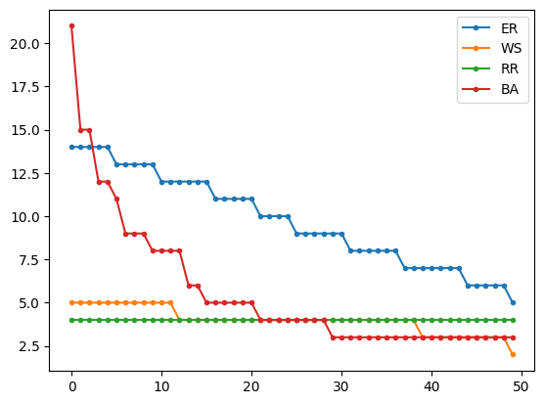
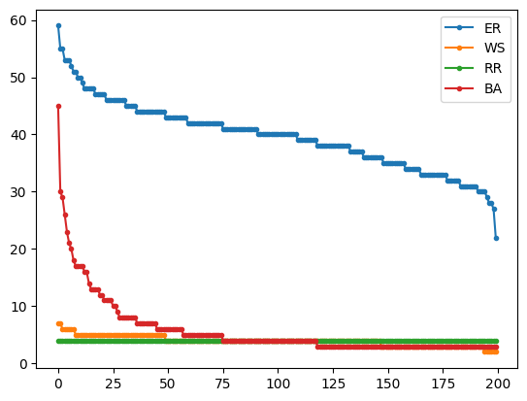
Properties of Graphs generated by Random models
Nodes: 20
Nodes: 200
Degree
distribution
Notes:
Erdos-Renyi Model has a binomial distribution over degree k. Ring lattice in WS - Dirac delta function. BA – scale-free (power law, P(k) = k^-3)

Slide 13
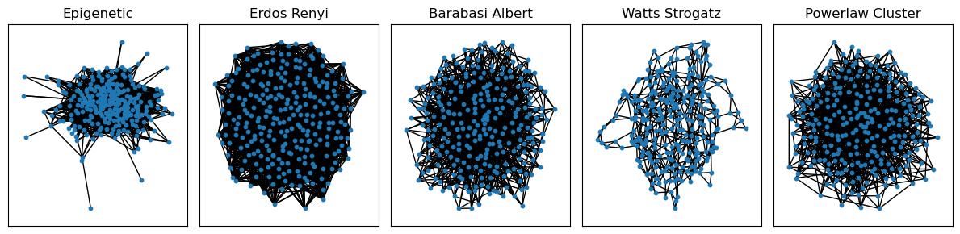
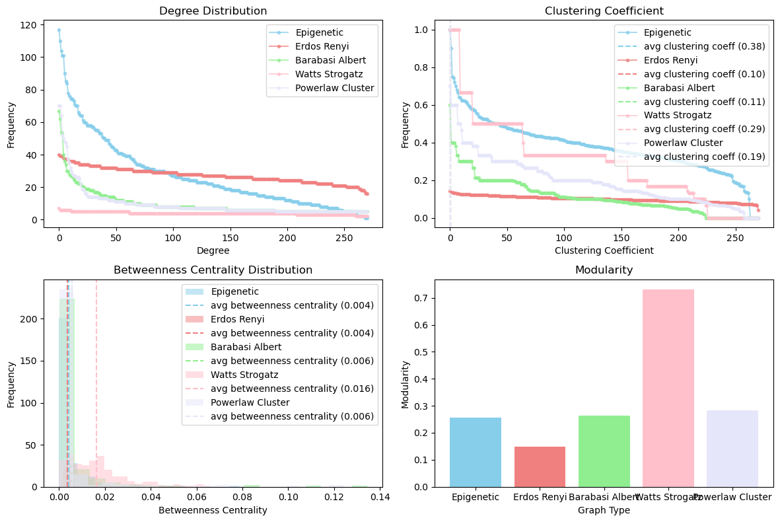
AD Biodomain Graph Networks Analysis
Notes:
whether Alzheimer Disease (AD) domain networks follow distribution of random models
Powerlaw cluster: It is essentially the Barabási–Albert (BA) growth model with an extra step that each random edge is followed by a chance of making an edge to one of its neighbors too (and thus a triangle). This algorithm improves on BA in the sense that it enables a higher average clustering to be attained if desired.
Clustering coeffiecient: measure of the degree to which its neighbors are connected to each other.
Betweenness Centrality: measure of the degree to which a node lies on the shortest path between other nodes in the graph
Modularity: measure of the degree to which a graph can be divided into communities or modules

Slide 14
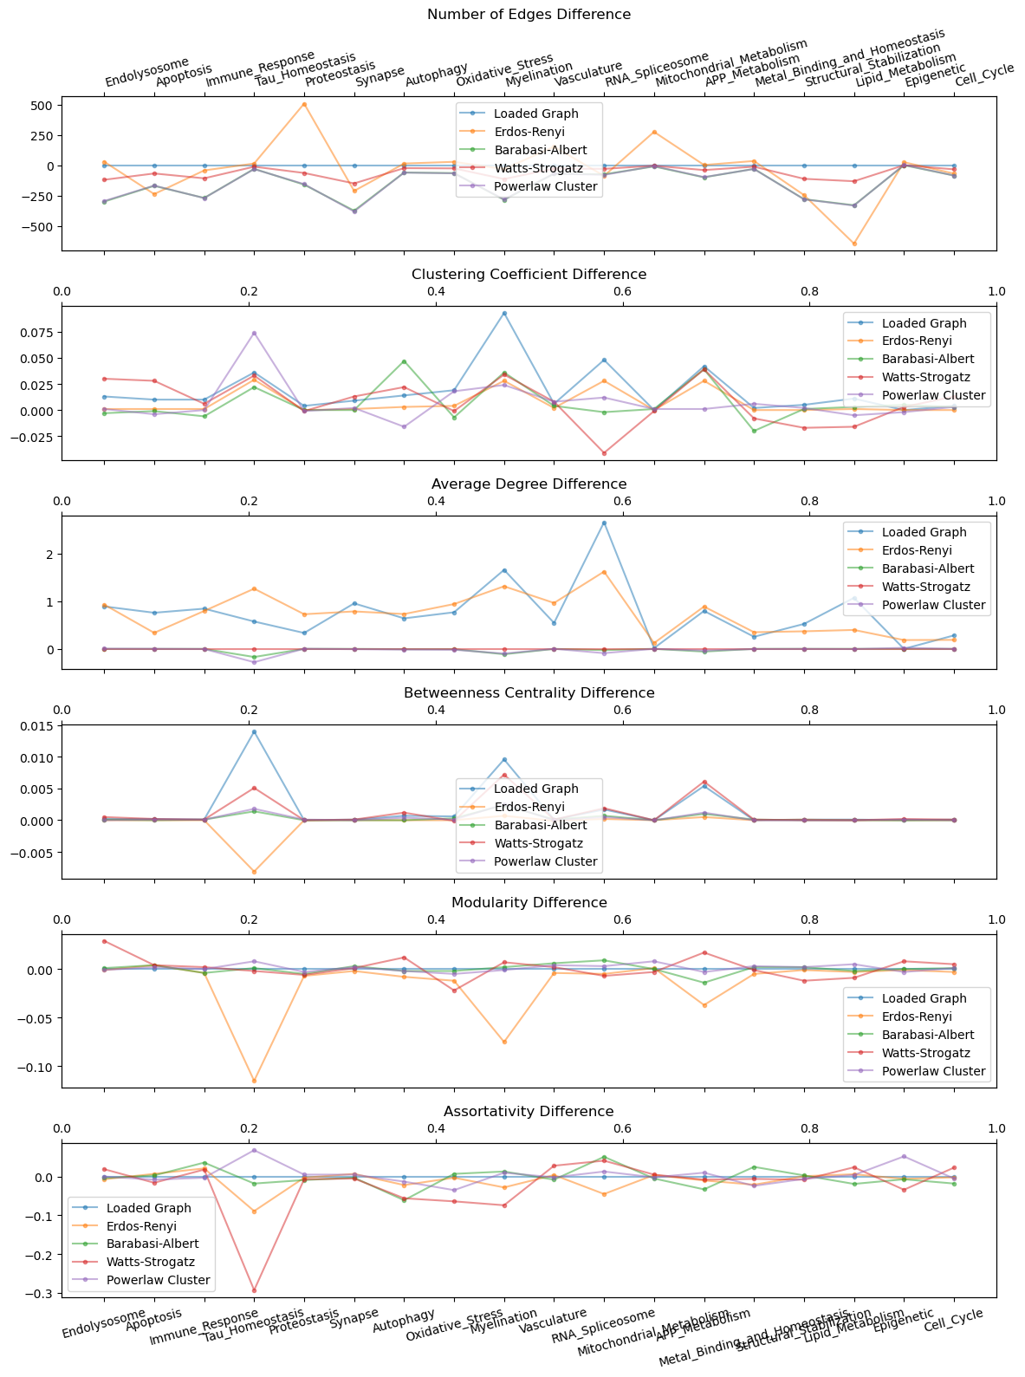
Properties of AD Biodomain Networks and Comparison with Random Models
Notes:
Assortativity is a measure of the tendency of nodes in a graph to be connected to other nodes with similar degrees.
In genetic datasets, assortativity can be used to identify genes that are highly connected to other genes with similar expression levels.

Slide 15
Assessing performance of interpretability methods
Generate graph dataset for graph classification with ground truth explanations
- random model type, graph sample size
Test (grid search) different GNN model configurations
- type of graph convolution , l2, dropout regularization
Test different interpretability methods
- Integrated Gradients, SHAP, GNNExplainer
Metrics for prediction and interpretability
- predictive accuracy
- interpretability: cross-entropy, AUC, correlation
Notes:
For cross-entropy calculation, all motif nodes are set to 1, rest to 0 in ground truth.

Slide 16
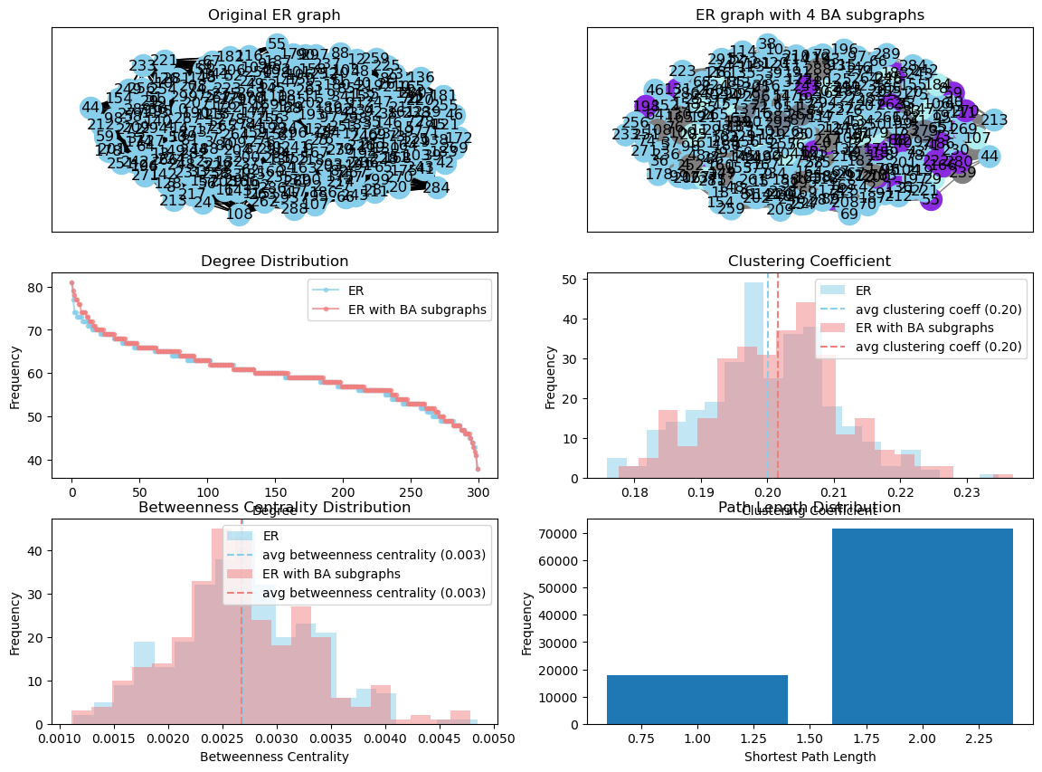
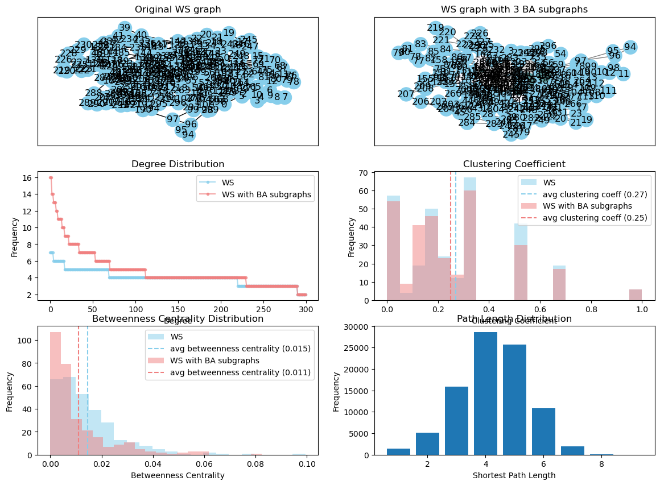
Graph Generation with Motifs
Create a large sparse graph using a specified base graph model and insert motifs by replacing a specified number of nodes with a specified graph model.
Notes:
Graph motifs are recurring subgraph patterns within a larger graph. Understanding graph motifs is crucial for various graph analysis tasks, as they capture important structural information.

Slide 17
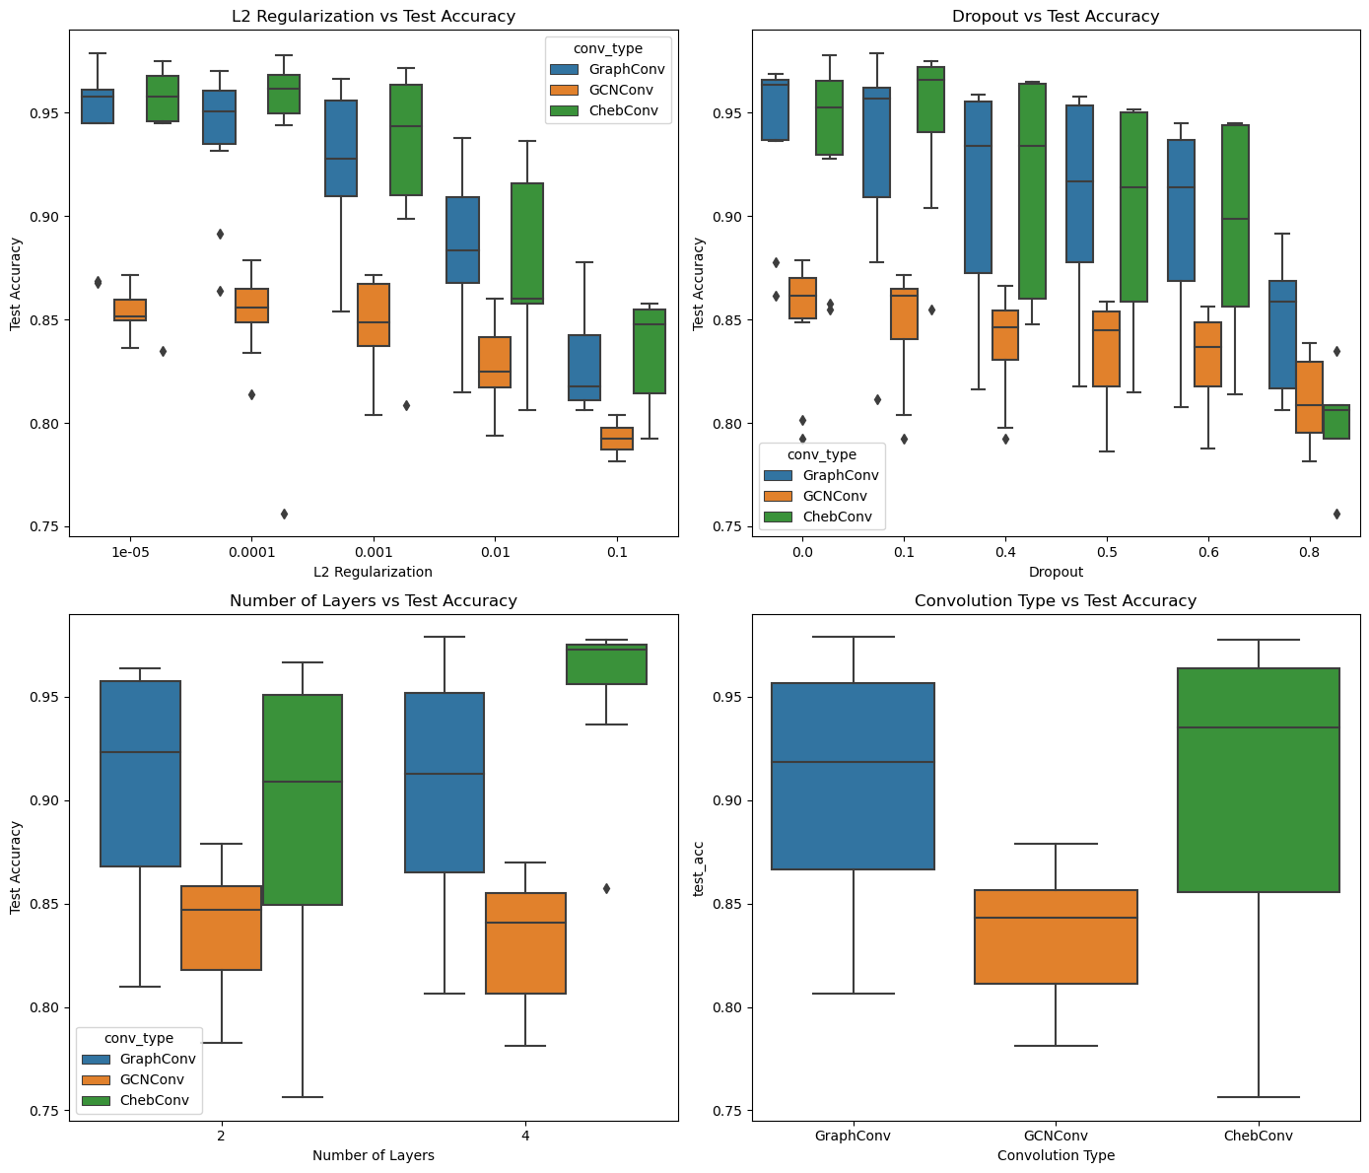
Regularization degrades GNN predictive performance
Dataset: 8000 samples
Train: 5600 {0: 2840, 1: 2760}
Valid: 1600 {0: 774, 1: 826}
Test: 800 {0: 416, 1: 384}
Notes:
Dataset: Synthetic Graph Dataset: 8000 samples
Train: 5600 {0: 2840, 1: 2760}
Valid: 1600 {1: 826, 0: 774}
Test: 800 {0: 416, 1: 384}

Slide 18
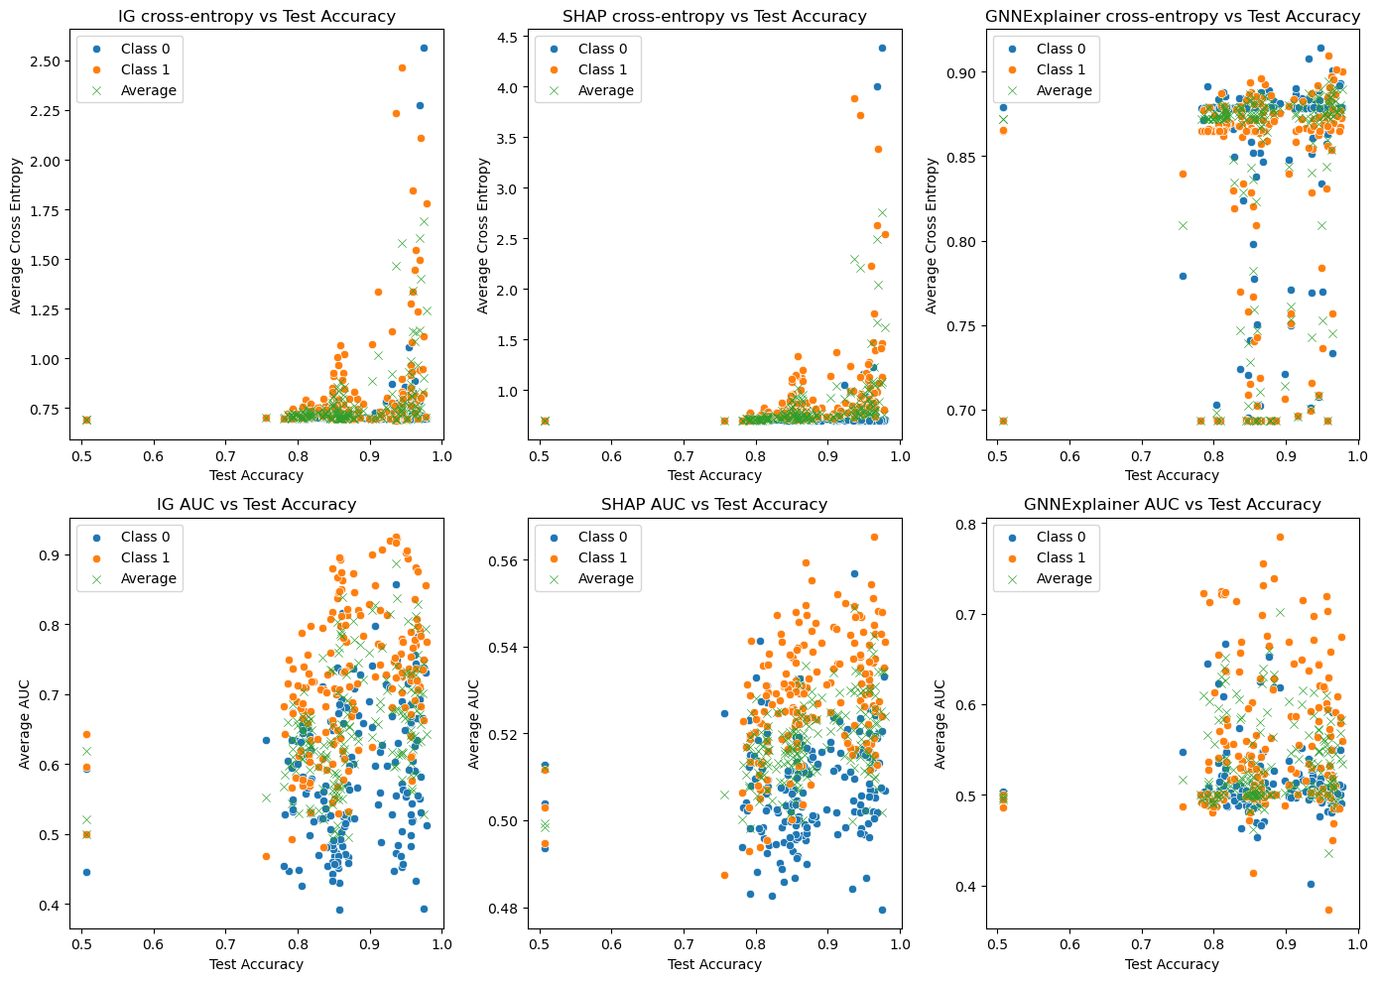
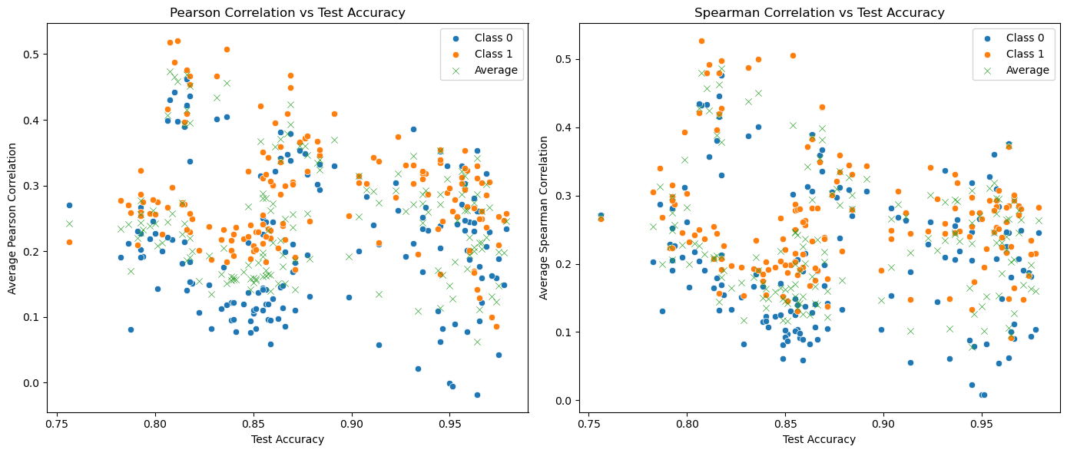
IG gives better explainability performance, and No correlation b/w accuracy and explainability
Explainability performance Vs Accuracy
Correlation b/w node importance and node degree Vs Accuracy

Slide 19
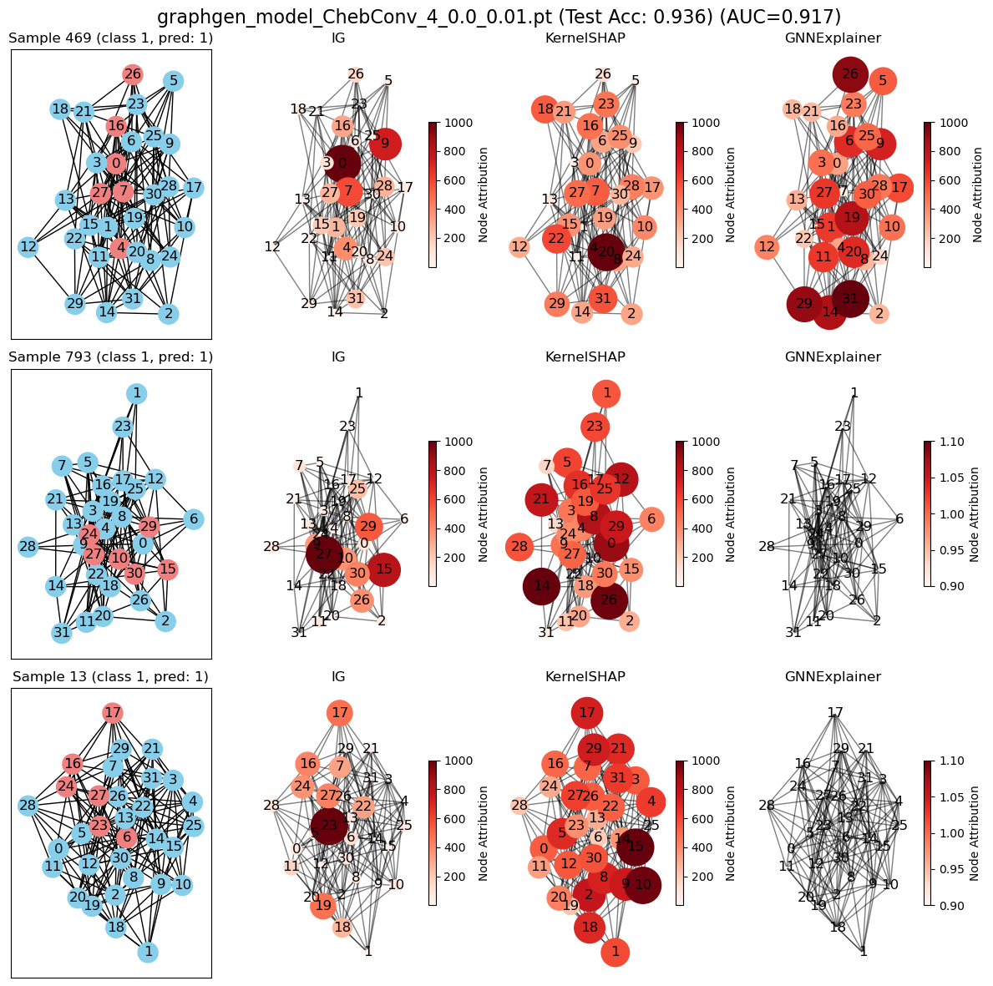
Integrated Gradients outperforms other methods (HIGH predictive performance model)
Model: ChebConv
No of layers: 4
Dropout: 0.0
L2: 0.01

Slide 20
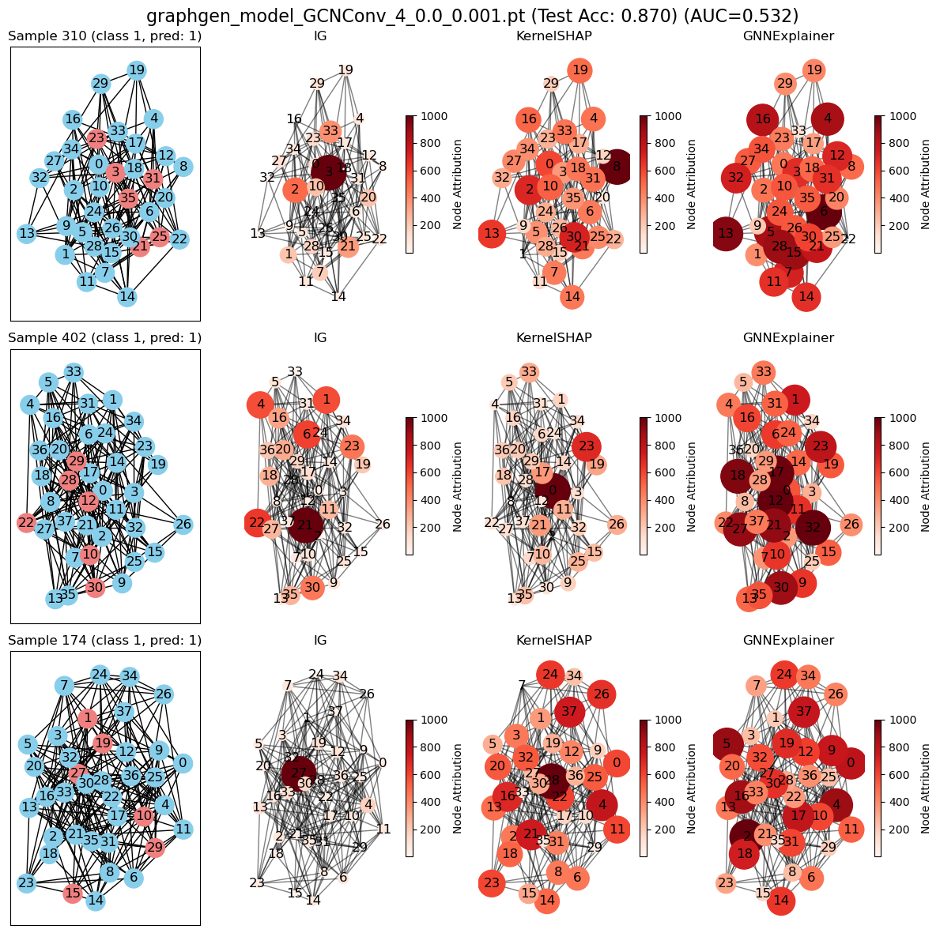
None of the Explainability methods work (LOW predictive performance model)
Model: GCNConv
No of layers: 4
Dropout: 0.0
L2: 0.001

Slide 21
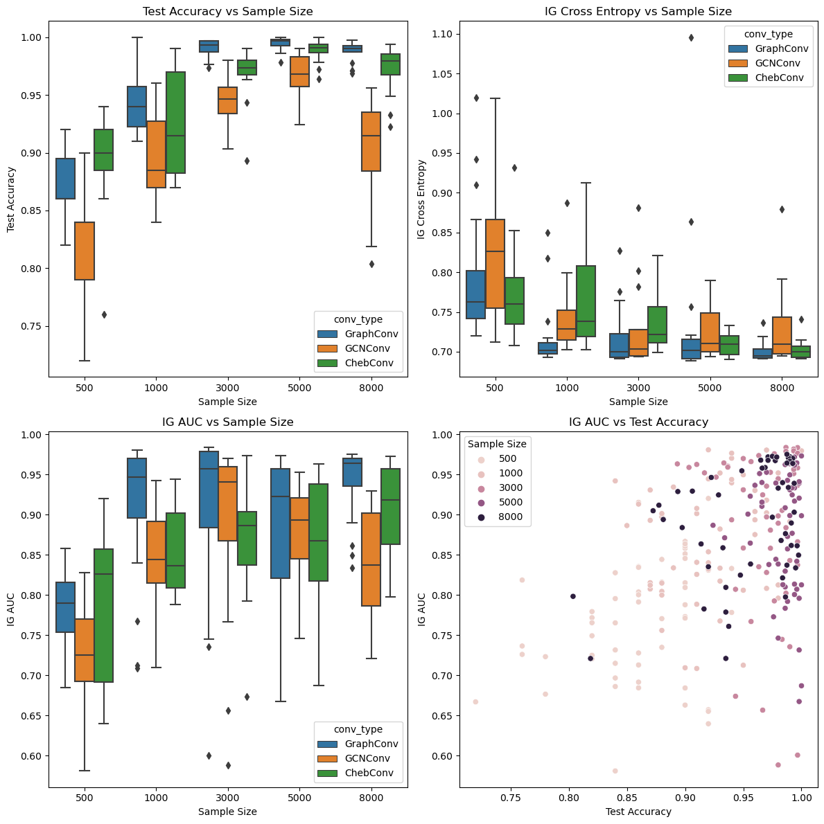
Explainability performance doesn’t consistently increase with sample size

Slide 22
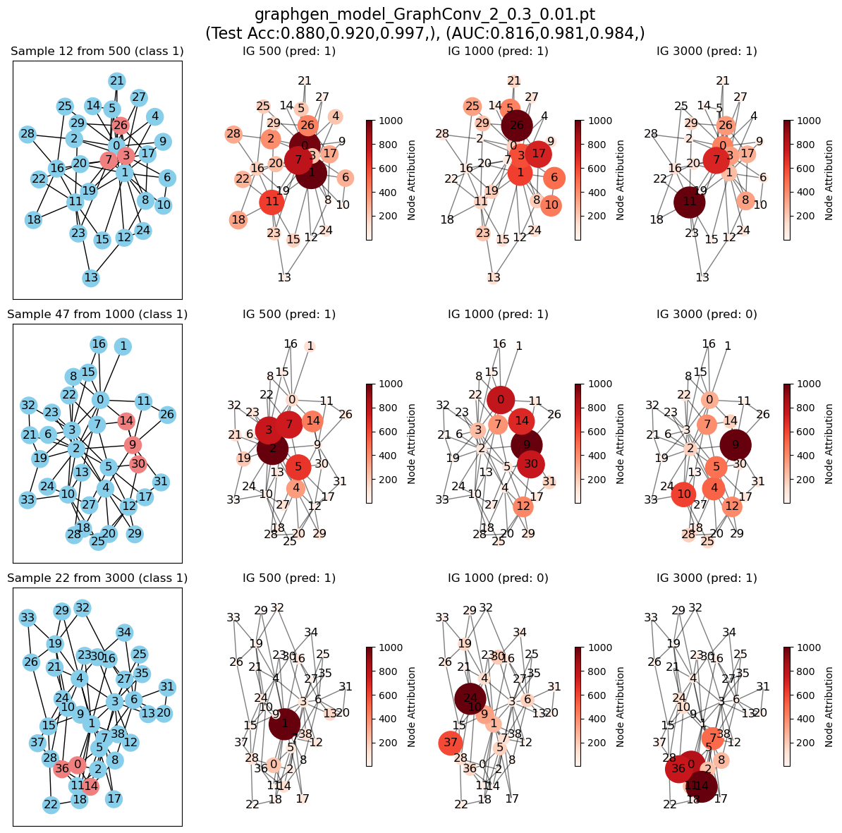
Explainability methods (Different sample sizes)
Model: GraphConv
No of layers: 2
Dropout: 0.3
L2: 0.01

Slide 23
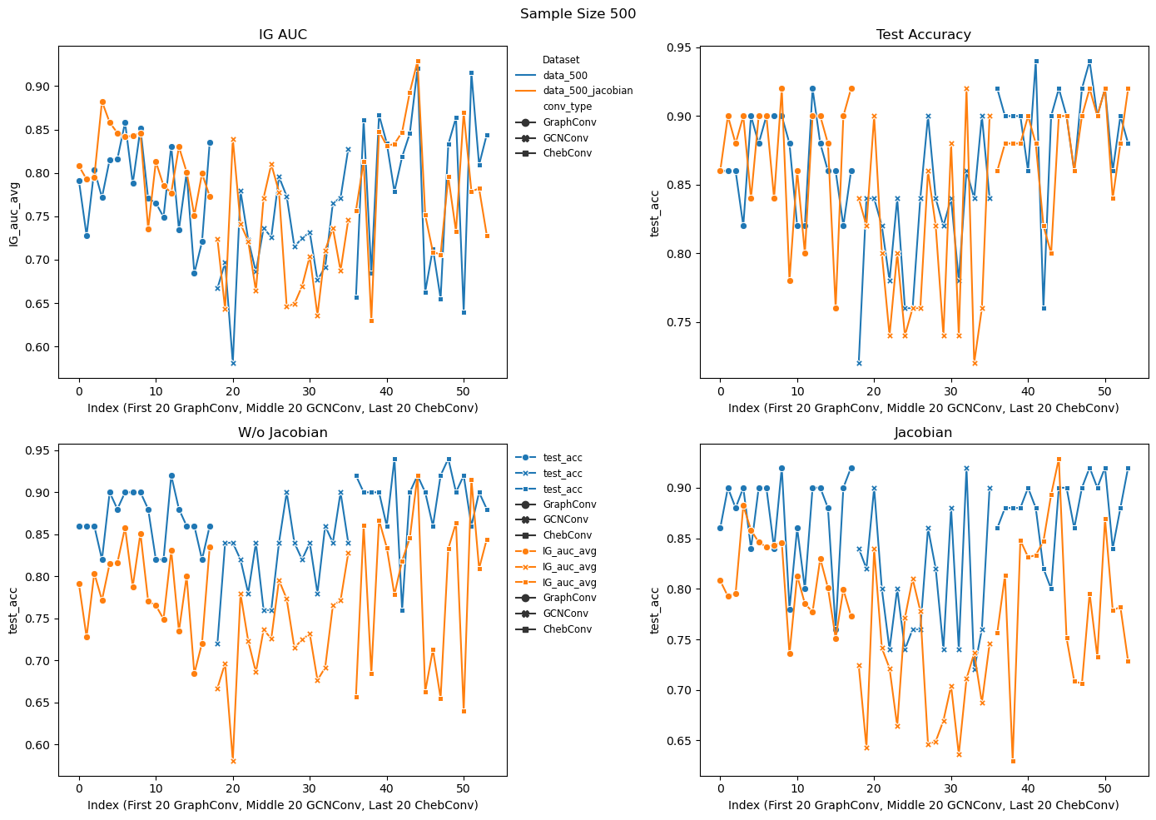
Jacobian regularization doesn’t improve explainability performance

Slide 24
Summary & Future Work
Need of model explainability methods
Discussed attribution approaches (gradient based: Saliency maps, Integrated gradients), KernelSHAP, GNNExplainer.
Generated synthetic dataset with motifs.
Assessed performance of interpretability methods on synthetic datasets.
Test Expected Gradient attribution (averaging over multiple baselines).
Experiment with different forms of attribution priors, such as graph topology-based or node feature-based priors, to guide the attribution process more effectively.
Notes:
Centrality Priors: If nodes that are central to a graph (like those with high betweenness centrality) are believed to be more influential, an attribution prior could emphasize these nodes during the interpretability analysis.
Community Priors: In graphs with clear community structures, priors could be set to evaluate how changes within or between communities affect model predictions.
Motif Priors: If certain motifs are hypothesized to be crucial for the model's decision, the attribution prior can be designed to focus on these subgraphs preferentially.
Feature Importance Priors: If prior knowledge or previous research suggests that certain node features are important, the interpretability method can be adjusted to reflect this, for example, by starting the feature attribution with non-uniform initialization that favors these features.

Slide 25
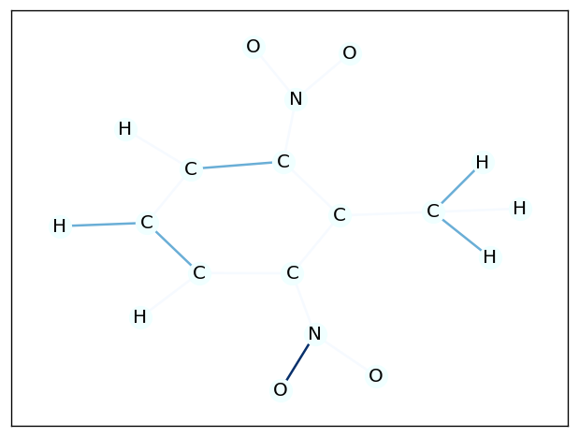
Results (GNNExplainer)

Slide 26
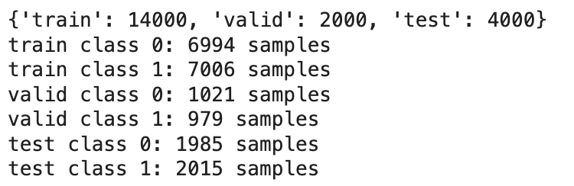
DATASET
Binary classification sequential synthetic dna dataset

Slide 27
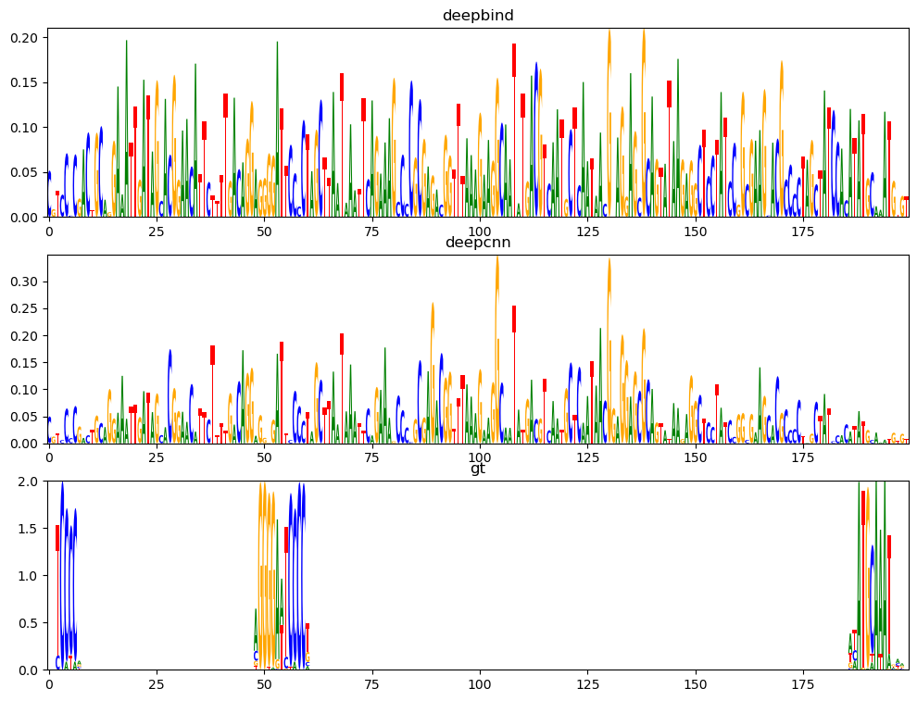
rESulTS (Saliency Maps)

Slide 28
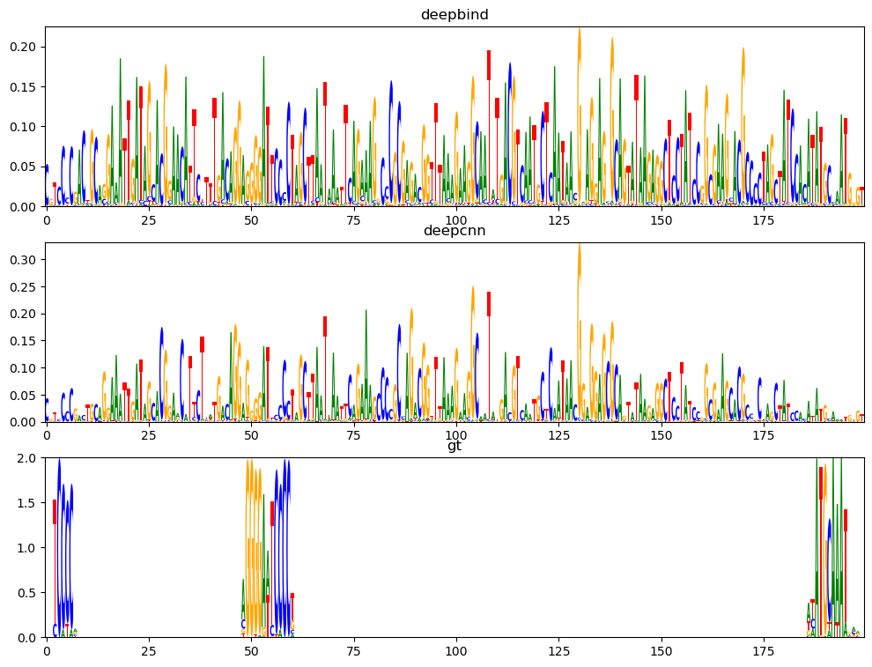
Results (smoothgrad)

Slide 29
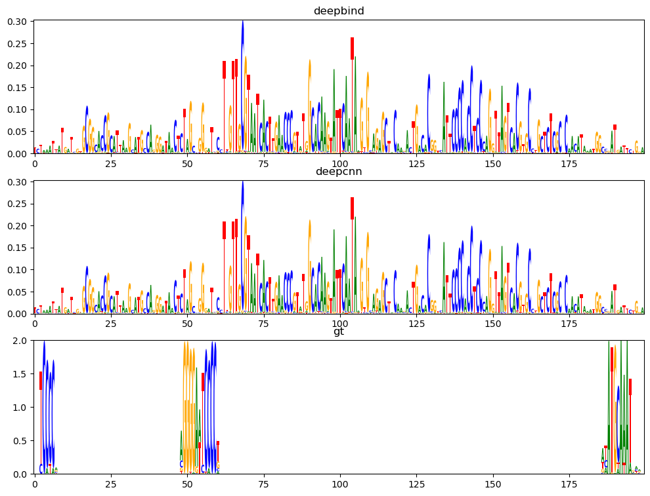
Results (Integrated Gradients)

